Slide 1
Performance of Recommender Algorithms on Top-N Recommendation Tasks ACM RecSys 2010 Paolo Cremonesi / Yehuda Koren / Roberto Turrin
報告者：陳克威
日 期：2019/11/29

Slide 2
Outline
Introduction
Testing Methodology
Collaborative Algorithms
Results
Discussion – PureSVD
Conclusions

Slide 3
Introduction

Slide 4

Introduction
Top-N
RMSE / MAE (X)
Precision / Recall (O)
Notes:
現在很多研究將RMSE做爲推薦算法的優化目標，但是現實生活中常用的是TopN推薦。
RMSE高不代表 Top-N表現就會好

Slide 5
Introduction
(1) we show that there is no trivial relationship between error metrics and accuracy metrics.
(2) we propose a careful construction of the test set for not biasing accuracy metrics.
(3) we introduce new variants of existing algorithms that improve top-N performance together with other practical benefits.
Notes:
（1）我們表明，誤差度量和準確性度量之間不存在瑣碎的關係。
（2）我們建議仔細構建測試集，以免偏誤準確性指標。
（3）我們介紹了現有算法的新變體，這些變體可提高top-N性能以及其他實際好處。

Slide 6
Testing Methodology

Slide 7
Testing Methodology
Data set : Netflix / MovieLens
Training set M
Test set T (The test set T contains only 5-stars ratings.)
Netflix : M = 100M ratings, T = 384,573 ratings. (from 1.4M)
MovieLens : M = 98.6%, T = ? (from 1.4%).

Slide 8
Testing Methodology
we first train the model over the ratings in M.
Then, for each item i rated 5-stars by user u in T :
(1) Randomly select 1000 additional items unrated by user u. We may assume that most of them will not be of interest to user u.
(2) Predict the ratings for the test item i and for the additional 1000 items.
(3) Rank them and let p denote the rank of the test item.
(4) We form a top-N recommendation list by picking the N top ranked items from the list. If p ≤ N we have a hit

Slide 9
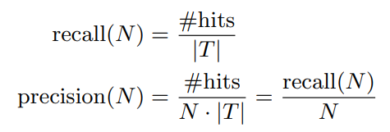
Testing Methodology
Recall : 0 or 1
Precision 0 or 1/N
Overall average

Slide 10
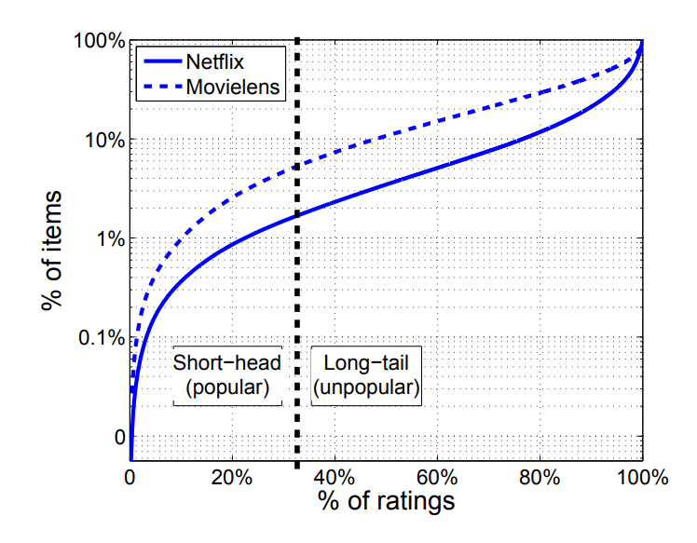
Testing Methodology
Thead Tlong

Slide 11
Collaborative Algorithms

Slide 12
Collaborative Algorithms
CF : (1) neighborhood approach.
(2) latent factor approach.

Slide 13
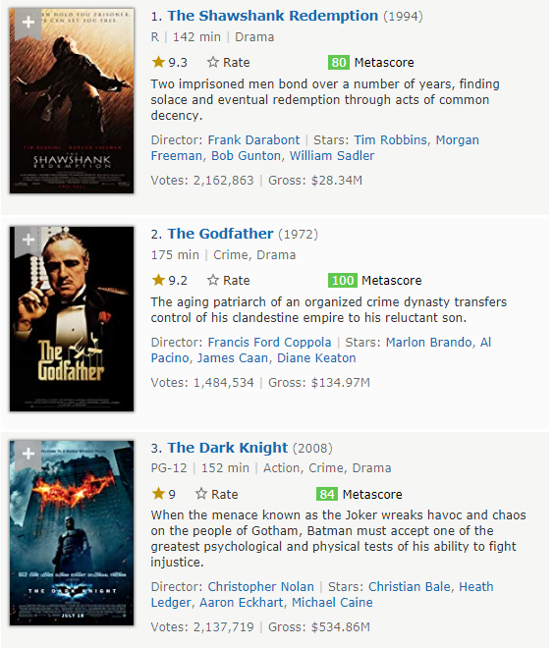
Collaborative Algorithms
Non-personalized models
(1) Movie Average (MovieAvg)
(2) Top Popular (TopPop)

Slide 14
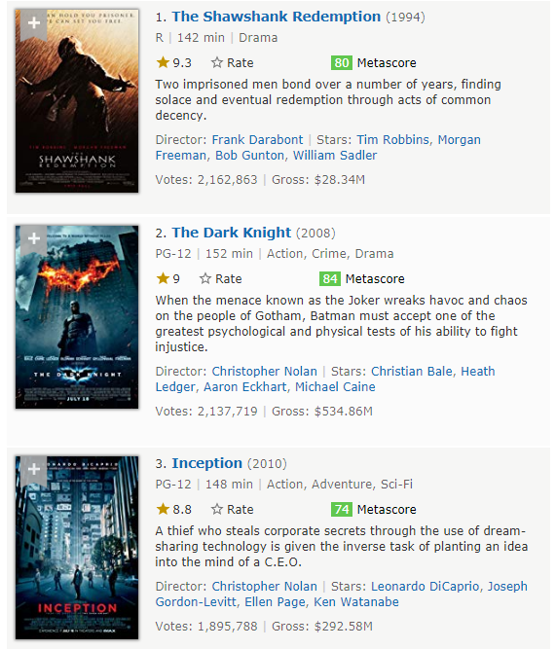
Collaborative Algorithms
Non-personalized models
(1) Movie Average (MovieAvg)
(2) Top Popular (TopPop)

Slide 15
Collaborative Algorithms
Neighborhood models
(1) user-based
(2) item-based
Interpretability (可解釋性)
Number of users > number of items

Slide 16
Collaborative Algorithms
The similarity between item i and item j :
Cosine
Adjusted cosine
Pearson correlation coefficient

Slide 17
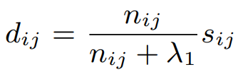
Collaborative Algorithms
nij = number of common raters
sij = the similarity between item i and item j
shrunk similarity dij :
A typical value of λ1 is 100.

Slide 18
Collaborative Algorithms
kNN :
When predicting rating rui, we consider only the k items rated by u that are the most similar to i.
We denote the set of most similar items by D k (u;i).
Notes:
畫圖
U = 5 3 0 1 0
假設 K = 2

Slide 19
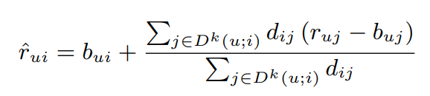

Collaborative Algorithms
Correlation Neighborhood (CorNgbr) :
sij = Pearson correlation coefficient.
Reference : Factorization Meets the Neighborhood: a Multifaceted Collaborative Filtering Model
Notes:
3.7 - 0.3 + 0.5

Slide 20

Collaborative Algorithms
Non-normalized Cosine Neighborhood :
sij = cosine similarity.
Notes:
K個item的相似度越高 ， 就越higher confidence

Slide 21

Collaborative Algorithms
Latent Factor Models :
Asymmetric-SVD (AsySVD)
SVD++

Slide 22

Collaborative Algorithms
PureSVD :
U = n × f
Σ = f × f
Q = m × f
we used a non-multithreaded SVD package, which factorized the 480K users by 17,770 movies Netflix dataset under 10 minutes on an i7 PC (f = 150).
PureSVD without any user-specific parameterization.
Not require tuning learning constants.

Slide 23
Results

Slide 24
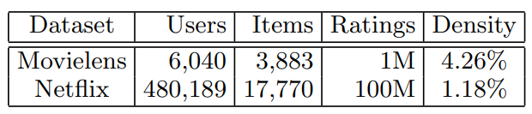
Results
Netflix RMSE:
(1) MovieAvg : 1.053
(2) TopPop
(3) CorNgbr : 0.9406
(4) NNCosNgbr
(5) AsySVD (f=200) : 0.9000
(6) SVD ++ (f=200) : 0.8911
(7) PureSVD 50
(8) PureSVD 150 (MovieLens) / 300 (Netflix)

Slide 25
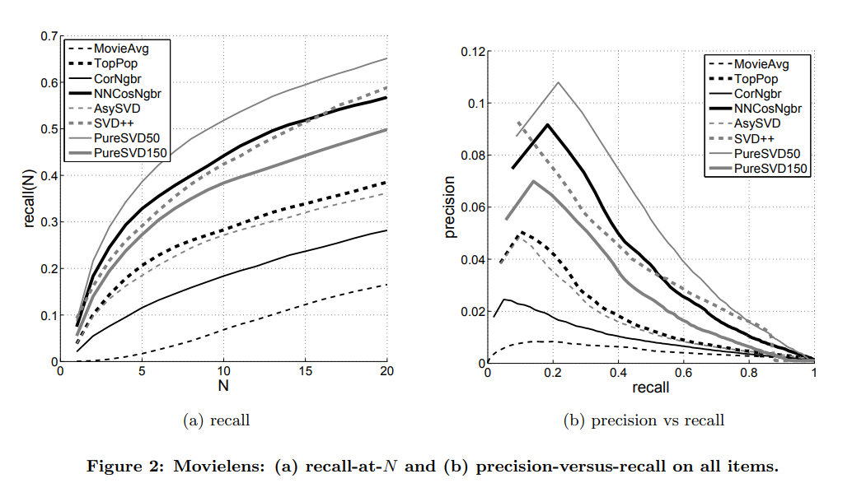
Results

Slide 26
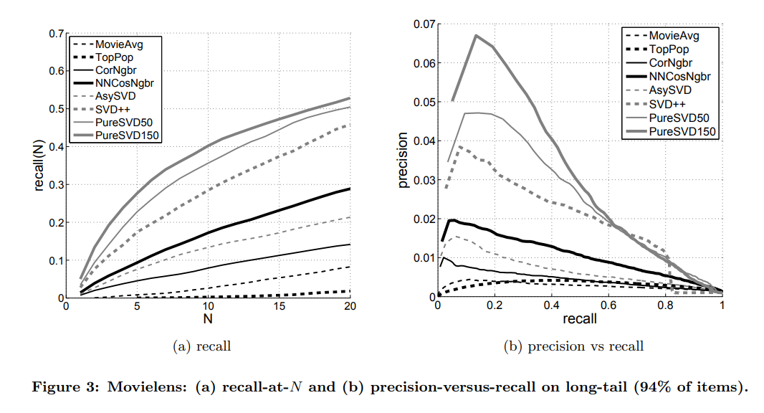
Results

Slide 27
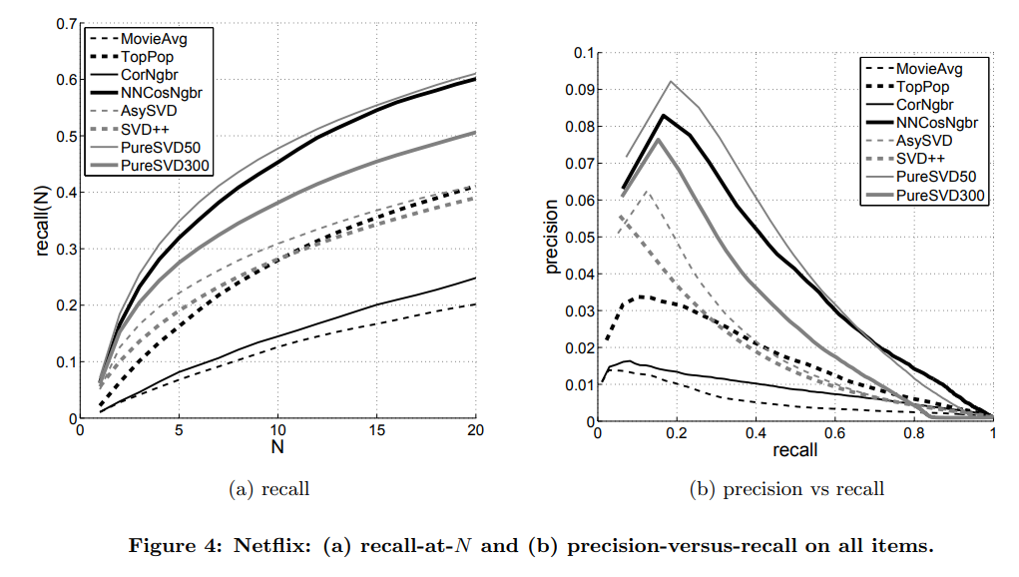
Results

Slide 28
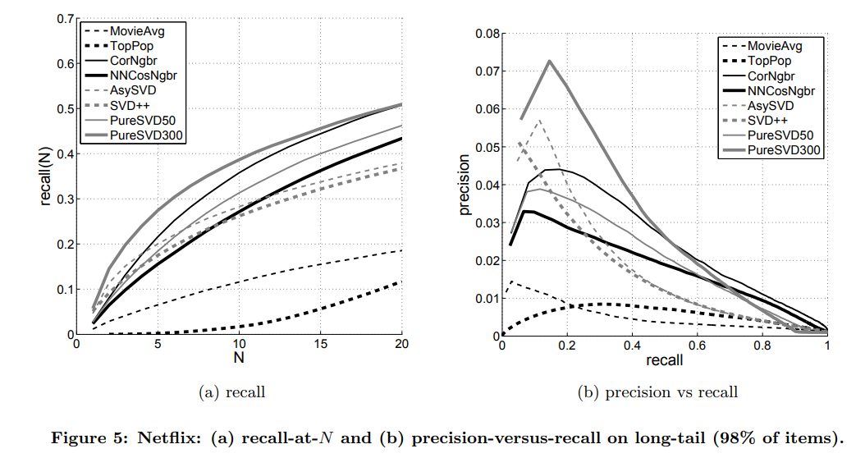
Results

Slide 29
Discussion - PureSVD

Slide 30
Discussion - PureSVD
(1) PureSVD 在 Movielens / Netflix 上的表現最好，即使它簡單、也沒有對RMSE作優化。
(2) 直接使用現有SVD package就可以實作，也不需要調整參數。
(3) 在長尾的部份，當PureSVD模型尺寸的提高時，準確性也會提高。

Slide 31
Conclusions

Slide 32
Conclusions
Evaluation of recommender has long been divided between
accuracy metrics (e.g., precision/recall)
error metrics (notably, RMSE and MAE).
However, it is well recognized that accuracy measures may be a more natural yardstick, as they directly assess the quality of top-N recommendations.

Slide 33
Conclusions
There is no monotonic relation between error metrics and accuracy metrics.
We have presented simple and efficient variants of known algorithms,
which are useless in RMSE terms, and yet deliver superior results when pursuing top-N accuracy.
Notes:
沒有直接(單調)關係

Slide 34
Conclusions
A careless construction of the test set would make recall and precision strongly biased towards non personalized algorithms.
An easy solution, which we adopted, was excluding the extremely popular items from the test set
(while retaining ∼98% of the items).
Notes:
測試集的粗心構造會使召回率和精度強烈偏向非個性化算法。
我們採用的一種簡單解決方案是從測試集中排除非常受歡迎的商品（同時保留約98％的商品）。

Slide 35
Conclusions
The resulting test set, which emphasizes the rather important nontrivial items, seems to shape better with our expectations.
First, it correctly shows the lower value of non-personalized algorithms.
Second, it shows a good behavior for the widely used correlation-based kNN approach, which otherwise (when evaluated on the full set of items) exhibits extremely poor results, strongly confronting the accepted practice
Notes:
最終的測試集強調了非常重要的重要內容，似乎可以符合我們的期望。
首先，它正確顯示了非個性化算法的較低價值。
其次，對於廣泛使用的基於相關性的kNN方法，它表現出良好的行為，否則（當對整套項目進行評估時）結果極差，強烈地接受了公認的實踐

Slide 36
Thanks for listening.
報告者：陳克威
日 期：2019/11/29

